Slide 1

St. MARTIN'S ENGINEERING COLLEGE
Dept. of CSE
BY:-
Y. PRANEETH (12K81A05J0)
Y. KESHAV (12K81A05H9)
G. VAMSHI KRISHNA (12K81A05D9)
L. ESWAR REDDY (12K81A05E8)

Slide 2

NUMBER SPECTRE
NUMBER
SPECTRE

Slide 3


Perfect way to
spend
Free time!!!
Takes hardwork
And skill!!

Slide 4
ABSTRACT
This Number puzzle Game( Number Spectre ) would be a perfect fit in the present day world.
A puzzle is a game or problem in which one is required to put pieces together, in a logical way, in order to arrive at the correct solution of the puzzle.
This puzzle consists of 4x4 blocks which contains numbers from 1-15 (which are jumbled) and an empty block or space

Slide 5
By making use of the empty block and using different move operations we have to arrange the jumbled numbers in order. This is the main aim of the game
The different types of operations used are:
right shift
left shift
up shift
Down shift

Slide 6
Proposed Application System
It is a Java application that is designed to work in Android operating system ( above 4.3).
The user interface deals with a set of random numbers from 0 to 15 if the 4*4 spectre is considered. The user is tasked to finish the game by arranging all the given randomly placed numbers in either a descending order or in an ascending order.

Slide 7

Advantages of the application
The brain functionality is tested and the capacity to think and focus greatly increases.
When free, using this application is a fruitful way to spend time effectively and
have fun at the same time.

Slide 8
SOFTWARE REQUIRMENTS:-
Android mobile with a minimum version 4.3.
HARDWARE REQUIRMENTS:-
Processor is not less than 500MHZ.
RAM is not less than 170MB.
SD card with minimum of 512MB.
Resolution is not less than 480*800pixs.

Slide 9
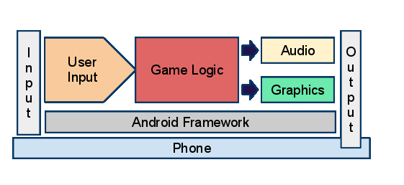
ARCHITECTURE

Slide 10
OPEN THE GAME
Activity diagram
Select a Mode
Start game
Arrange blocks using shift operations
All numbers in ascending order
Increment no.of Moves
Move+1
GAME ENDS

Slide 11
Use Case Diagram
Start Game
<<Includes>>
Difficulty: Easy
<<Includes>>
<<Includes>>
Difficulty: Medium
<<Includes>>
Difficulty: Hard
<<Includes>>
About

Slide 12
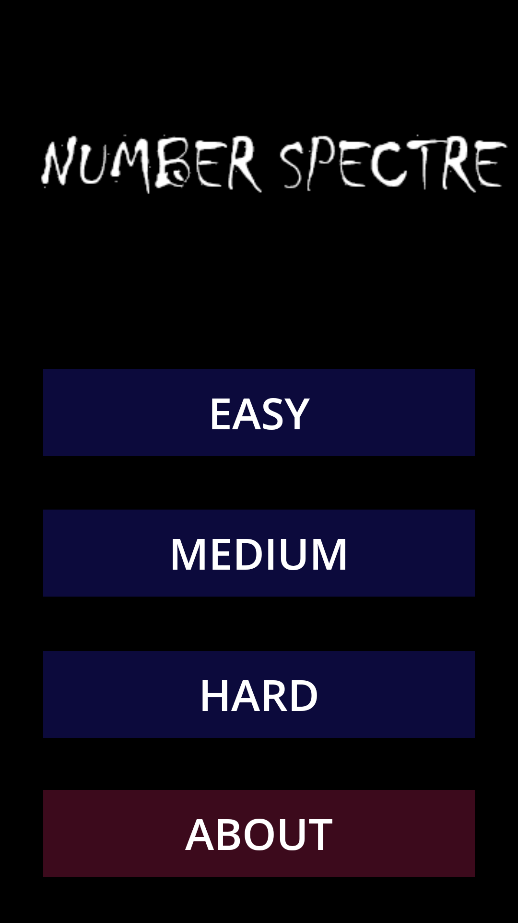
Screenshots

Slide 13
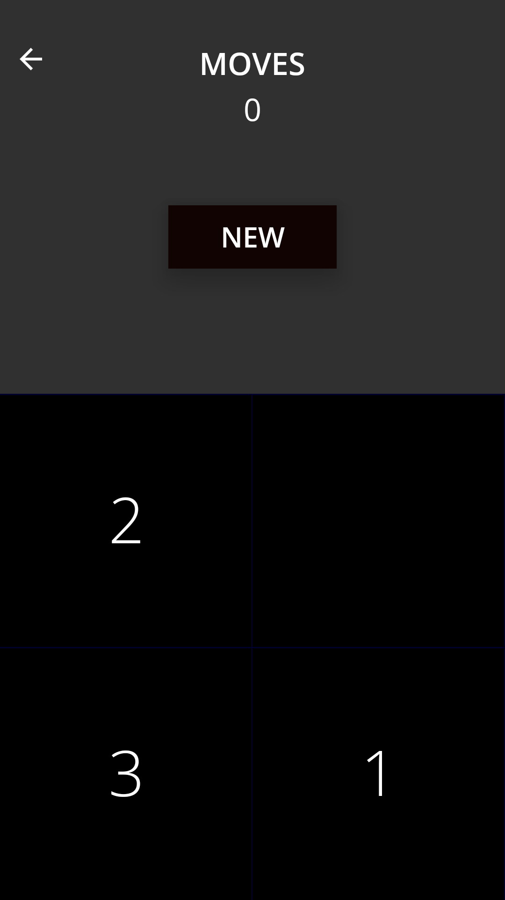
EASY

Slide 14
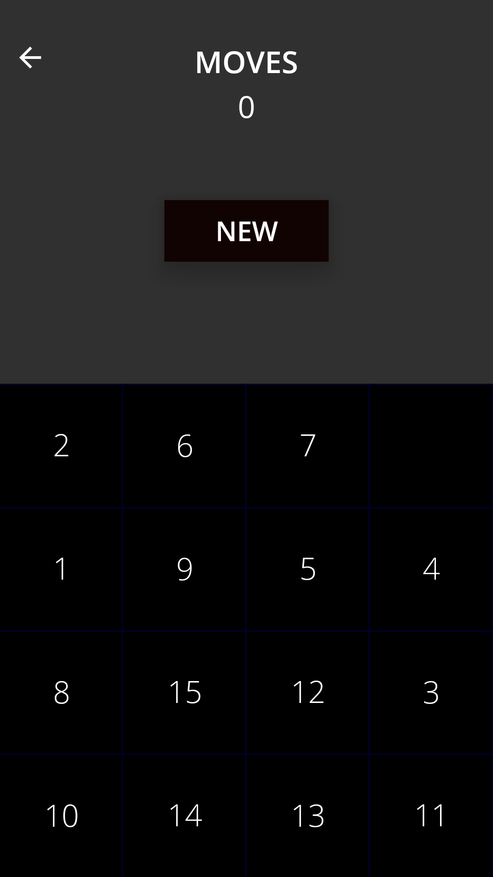
Medium

Slide 15
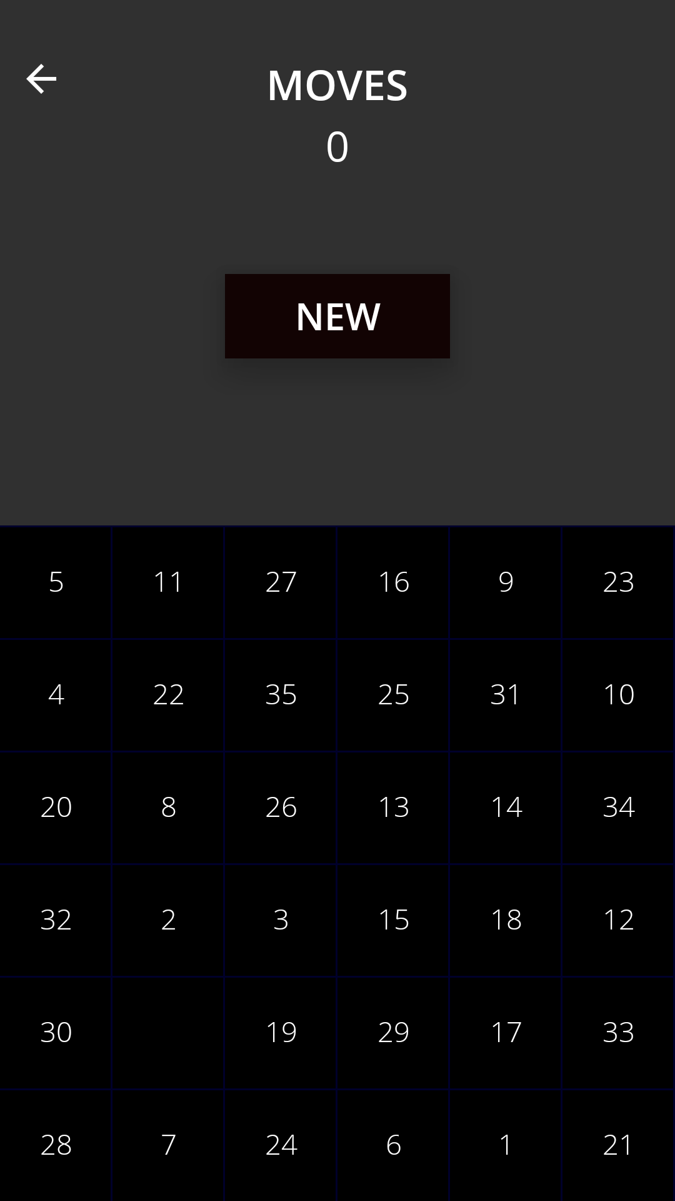
HARD

Slide 16
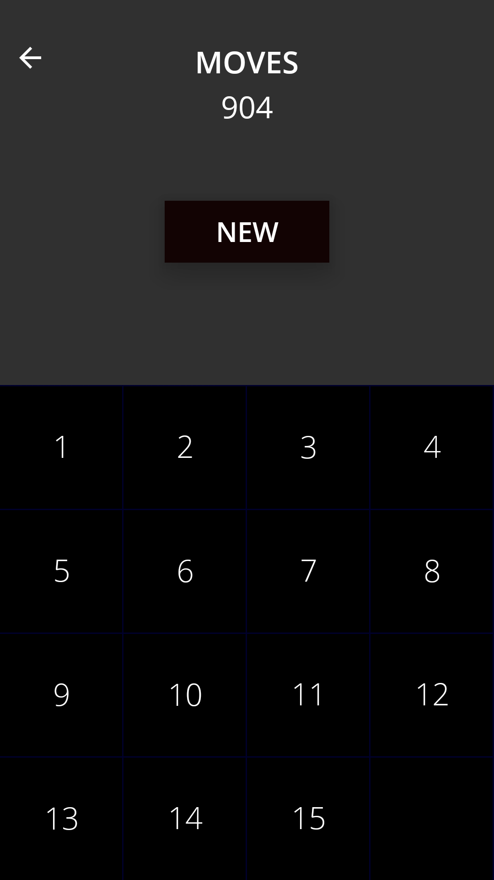
Completed game

Slide 17
CONCLUSION
This Number puzzle Game (Number Spectre ) would be a perfect fit in the present day world.
This is an android application that runs on device having android version 4.3(Jelly Bean) and above.
The user interface of the game is also very friendly. Anybody can use it.
Thus this would be a very interesting game to play when feeling bored.

